Slide 1

SOCIONICS
All slides are copyrighted by Jack Oliver Aaron of the World Socionics Society
A CRASH COURSE

Slide 2
9. GAMMA
All slides are copyrighted by Jack Oliver Aaron of the World Socionics Society

Slide 3
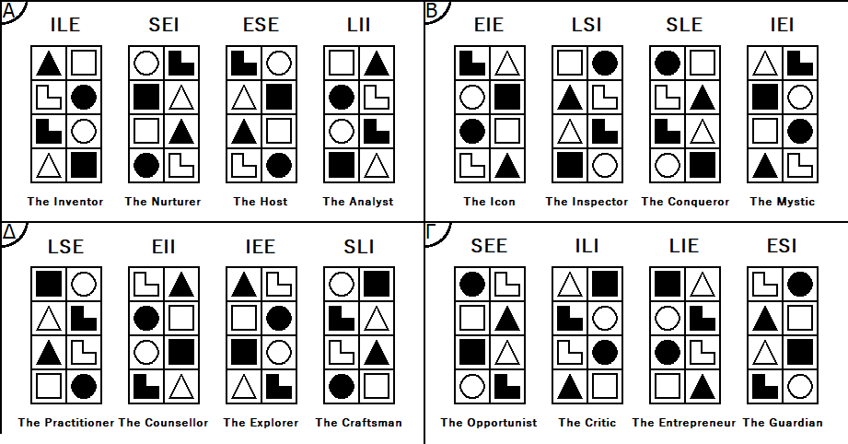
SO FAR
All slides are copyrighted by Jack Oliver Aaron of the World Socionics Society
Information Elements
Information Metabolism
Functions
Types
Alphas
Betas

Slide 4
WHAT’S NEXT
All slides are copyrighted by Jack Oliver Aaron of the World Socionics Society
Information Elements
Information Metabolism
Functions
Types
Alphas
Betas
Gammas

Slide 5
GAMMA VALUES
All slides are copyrighted by Jack Oliver Aaron of the World Socionics Society
All Valued Elements are Repulsive.
Thinking independently and acting autonomously
Identifying and avoiding present threats and future risks
Being critical and resisting stupid ideas or evil intentions
Exercising one’s own competence and initiative for personal success

Slide 6
GAMMA TABOOS
All slides are copyrighted by Jack Oliver Aaron of the World Socionics Society
All Neglected Elements are Attractive.
Falling to peer pressure rather than thinking for oneself
Brushing over real problems with superficial positivity
Wasting time with useless ideas that only make sense in theory
Embracing mediocrity, being lazy, and lacking personal ambition

Slide 7
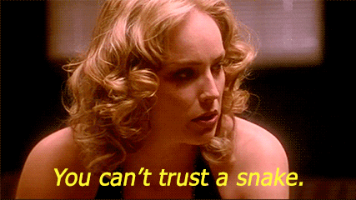
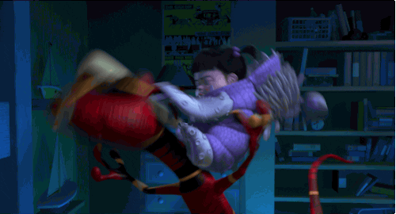
GAMMA SOCIALITES
All slides are copyrighted by Jack Oliver Aaron of the World Socionics Society
People are individuals, not aligned Some cannot be trusted, some can Know where you stand with others Build relationships that serve you
The Opportunist - SEE
The Guardian - ESI

Slide 8
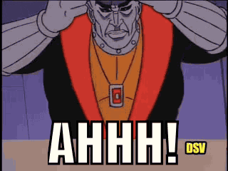
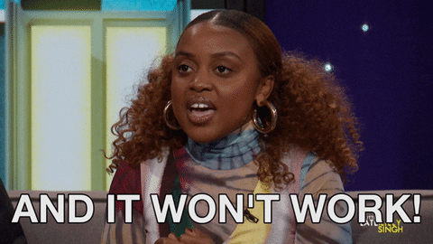
GAMMA INTELLECTUALS
All slides are copyrighted by Jack Oliver Aaron of the World Socionics Society
Every theory is flawed Some are less bad than others Think critically and independently Do what works best long term
The Critic - ILI
The Entrepreneur - LIE

Slide 9

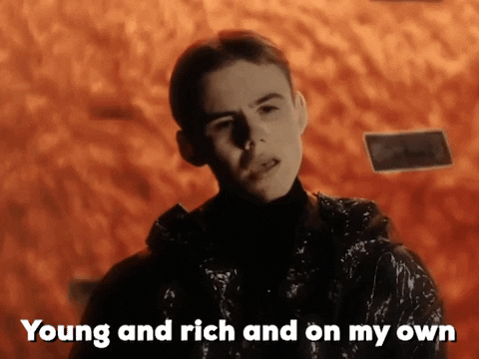
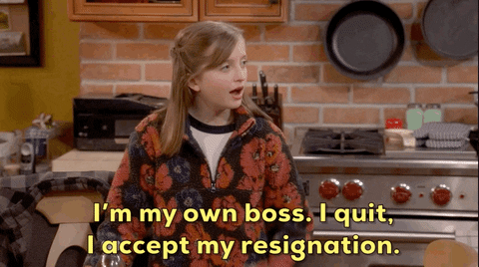
GAMMA ENERGISERS
All slides are copyrighted by Jack Oliver Aaron of the World Socionics Society
Don’t let anything hold you back Knowledge is power Be the very best at what you do Win your independence from others
The Opportunist - SEE
The Entrepreneur - LIE

Slide 10
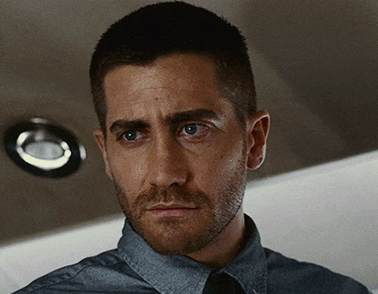
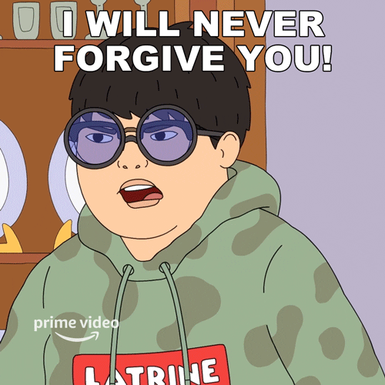
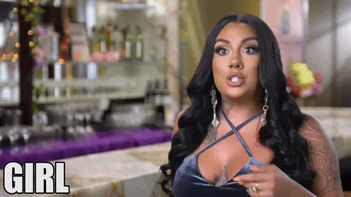
GAMMA INTEGRATORS
All slides are copyrighted by Jack Oliver Aaron of the World Socionics Society
Be sceptical and prudent, avoid risks Don’t associate with just anyone Only a few people should really matter Nothing wrong with saying ‘no’
The Critic - ILI
The Guardian - ESI

Slide 11
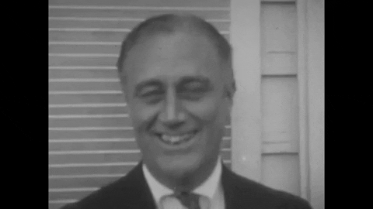
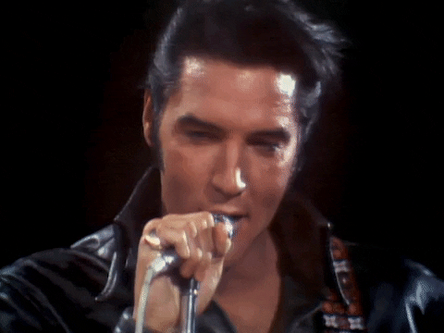
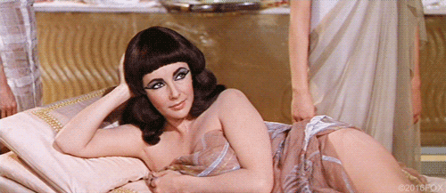

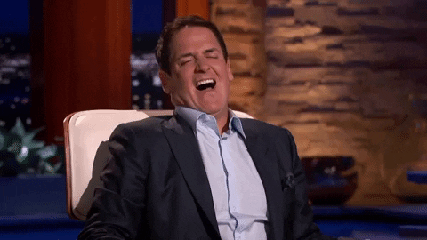
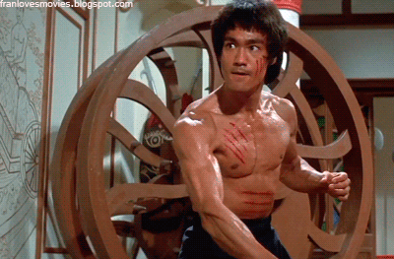
SENSORY ETHICAL ENERGISER - “THE OPPORTUNIST”
All slides are copyrighted by Jack Oliver Aaron of the World Socionics Society

Slide 12
EGO BLOCK
All slides are copyrighted by Jack Oliver Aaron of the World Socionics Society
All about independent achievement Overcomes obstacles through willpower Enters conflict to protect autonomy Takes initiative to succeed in any situation Quick to size people up, friend or foe Finds a way to work with each person ‘First among equals’ leadership Acts swiftly against disloyalty
Notes:
Mark Cuban F1+R2: https://www.youtube.com/watch?v=Go2sPLvBkfA&t=47s
Julius Caesar F1+R2: https://www.youtube.com/watch?v=KJDPnP8lnjE

Slide 13
SUPER-EGO BLOCK
All slides are copyrighted by Jack Oliver Aaron of the World Socionics Society
Action-oriented, devalues speculation Prefer direct approach over ‘out the box’ Need a personal relationship to explore Can seek out new possibilities if needed Often can’t simplify data to clear rules Can be erratic and inconsistent in actions Uninterested in theory, hate red tape May mix and match contradictory things
Notes:
Bruce Lee I3+L4: https://www.youtube.com/watch?v=nzQWYHHqvIw

Slide 14
SUPER-ID BLOCK
All slides are copyrighted by Jack Oliver Aaron of the World Socionics Society
Lacks strategic insight Can act in moment without thinking Ploughs forward until hitting a snag Open to advice on which plans are bad Want competence, knowledge is power Learn and practise useful skills Overcome more obstacles by learning Takes a ‘whatever works’ approach
Notes:
Mark Cuban T5: https://www.youtube.com/shorts/c1vcosZYbTk
Mark Cuban P6: https://www.youtube.com/watch?v=xRaO1mN5EEM

Slide 15
ID BLOCK
All slides are copyrighted by Jack Oliver Aaron of the World Socionics Society
Tends to be tough, potentially intimidating Intense and achievement-striving Yet good at managing aesthetic Inclined to ignore pain in order to win Often full of energy and emotivity Able to win over almost anyone Takes their likeability for granted Looks at mood to measure competence
Notes:
Paris Hilton S7: https://www.youtube.com/watch?v=tFSxWhLH318 Paris Hilton S7: https://www.youtube.com/watch?v=B7FOK65iNII
Elvis Presley E8: https://www.youtube.com/watch?v=MMmljYkdr-w

Slide 16
DOMINATION
All slides are copyrighted by Jack Oliver Aaron of the World Socionics Society
Inclined towards intensity of action ‘No pain no gain’, denies comfort for ambition Dominate surroundings, does not blend in Makes space competitive, not harmonised May not allow others to relax
Notes:
Tony Robbins F1>S7: https://www.youtube.com/watch?v=-LjQ5-MdBkk
Joe Rogan F1>S7: https://www.youtube.com/watch?v=CM_LWxh33Z8&t=132s

Slide 17
MASKING
All slides are copyrighted by Jack Oliver Aaron of the World Socionics Society
Strongly prefer direct, forceful action Dislike open-ended speculation Do not want to be tied to a losing battle If necessary, will entertain alternative ideas
Notes:
Mark Cuban F1 -> I3: https://www.youtube.com/watch?v=B6pCuhvWBJA

Slide 18
STRUGGLE
All slides are copyrighted by Jack Oliver Aaron of the World Socionics Society
Reluctantly entertains alternative ideas Does not like to feel distracted from action Think they need to account for possibilities Desire a clear goal to work tirelessly towards Freed from pointlessness by having purpose
Notes:
Joe Rogan I3>T5: https://www.youtube.com/watch?v=H914hYJVmyM&t=231s

Slide 19
DISTRACTION
All slides are copyrighted by Jack Oliver Aaron of the World Socionics Society
Normally receptive to strategic advice If not in control, will obsess over details Lose sight of their goals for daily comforts Need autonomy to shape their future

Slide 20
MASTERY
All slides are copyrighted by Jack Oliver Aaron of the World Socionics Society
Very charming and captivating Can work a room, and bond one-to-one Charming in service of building close bonds Easily win over the people they like Often trusted and respected as a leader
Notes:
Tony Robbins R2<E8: https://www.youtube.com/watch?v=hrEfTxsyfhA

Slide 21
GROWTH
All slides are copyrighted by Jack Oliver Aaron of the World Socionics Society
Very likeable, take charisma for granted Acquire knowledge to become competent Lack of consistency limits effectiveness Regress to socialising and people-pleasing
Notes:
Joe Rogan E8 -> P6: https://www.youtube.com/watch?v=CM_LWxh33Z8

Slide 22
SUBSTITUTION
All slides are copyrighted by Jack Oliver Aaron of the World Socionics Society
Struggle to recognise objective rules Default to personal likes/dislikes Tailor decisions to the individual Help their friends regardless of the rules
Notes:
Jacques Chirac L4 -> R2: https://www.youtube.com/watch?v=Q-LT_kJNdrY

Slide 23
HUBRIS
All slides are copyrighted by Jack Oliver Aaron of the World Socionics Society
Blind to underlying rules and structures Yet want to feel competent and capable Learn and apply facts case-by-case Bastardise theories, lacking rhyme or reason Solutions may fail, unable to pass skills on
Notes:
Mark Cuban L4<P6: https://www.youtube.com/watch?v=rCd2vWsWWrI&t=238s
Julius Caesar L4<P6: https://www.youtube.com/watch?v=ckUeZt39UR8

Slide 24
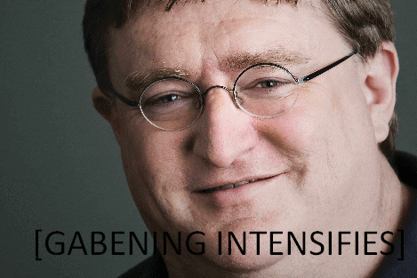
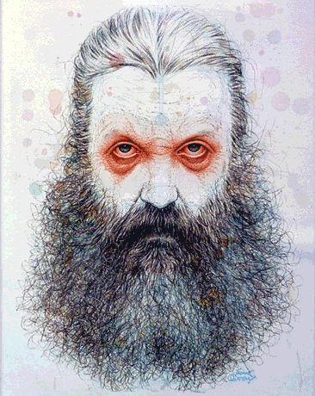
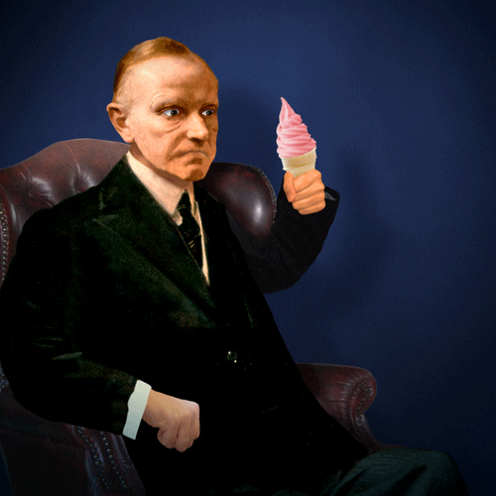

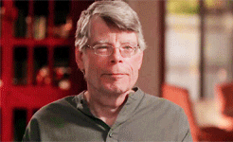
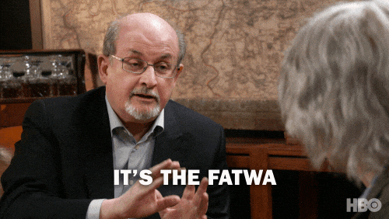
INTUITIVE LOGICAL INTEGRATOR - “THE CRITIC”
All slides are copyrighted by Jack Oliver Aaron of the World Socionics Society

Slide 25
EGO BLOCK
All slides are copyrighted by Jack Oliver Aaron of the World Socionics Society
All about reducing bad outcomes Thinks carefully about the past and future Identifies trends/trajectories of events Scrutinises ideas, thinking about risks Processes large amounts of data Uses the facts to support/disprove ideas Often an expert in a particular field Empirically minded, tests conclusions
Notes:
David Starkey T1+P2: https://www.youtube.com/watch?v=TvwPybHC5xw&t=251s

Slide 26
SUPER-EGO BLOCK
All slides are copyrighted by Jack Oliver Aaron of the World Socionics Society
Dislikes small talk or trivial matters Eschews hedonism for long-term needs Need a practical need to focus on details Can be rigorous and precise if needed Matter-of-fact, even austere in style Do not naturally express their emotions Have no interest in being popular Speak plainly, even offensively
Notes:
David Starkey S3+E4: https://www.youtube.com/watch?v=B1D6Tfpo1RQ

Slide 27
SUPER-ID BLOCK
All slides are copyrighted by Jack Oliver Aaron of the World Socionics Society
Slow strategic thinkers, not fast or tactical Need to think things through to act Attracted to proactive, energetic people Appreciate the willpower to act decisively Take relationships very seriously Can be very loyal to particular people Harsh in judgement of others All-or-nothing, can self-isolate if let down
Notes:
David Starkey F5+R6: https://www.youtube.com/watch?v=oj9dA6E3fJw

Slide 28
ID BLOCK
All slides are copyrighted by Jack Oliver Aaron of the World Socionics Society
Focused on ideas that are relevant Tend to reject new ideas, seeing risks Good at speculating on possibilities Unlikely to give things a chance Highly systematic thinkers Can easily spot logical contradictions Sceptical rather than ideological Sees ideas as tools to test and replace
Notes:
Karl Popper I7+P8: https://www.youtube.com/watch?v=li0ciaqJ0m0

Slide 29
DOMINATION
All slides are copyrighted by Jack Oliver Aaron of the World Socionics Society
Want to pursue a meaningful strategy Focused on relevance, without distractions Avoid new possibilities, seeing the risks Explore everything in line with their goals Critical of new ideas and opportunities
Notes:
David Starkey T1>I7: https://www.youtube.com/watch?v=z1AH_lKDQF8&t=175s

Slide 30
MASKING
All slides are copyrighted by Jack Oliver Aaron of the World Socionics Society
Pursue what is transcendent over trivial See day-to-day things as unimportant Feel need to be detailed in their scrutiny Outwardly appear relaxed, not intense
Notes:
David Starkey T1 -> S3: https://www.youtube.com/watch?v=rmCALvfIDlg&t=33s
Tarl Warwick T1 -> S3: https://www.youtube.com/watch?v=I3rSgXl6Vhk

Slide 31
STRUGGLE
All slides are copyrighted by Jack Oliver Aaron of the World Socionics Society
Naturally cautious in present day Feels the need to play things safe Finds the safe and secure very boring Admires those with strength and will to act Feel empowered and emboldened by others
Notes:
Henry Kissinger S3>F5: https://www.youtube.com/watch?v=OdKMtaKbvYs
David Starkey S3>F5: https://www.youtube.com/watch?v=rmCALvfIDlg

Slide 32
DISTRACTION
All slides are copyrighted by Jack Oliver Aaron of the World Socionics Society
Normally receptive to intensity and urgency Occasionally needs to find a new strategy Grow distracted in exploration Need the path ahead to be spurred to action

Slide 33
MASTERY
All slides are copyrighted by Jack Oliver Aaron of the World Socionics Society
Excellent at collating and arranging data Crunches information to turn up new insights Balances pragmatism with structural analysis Builds loose theories out of evidence Theories are mere tools to be improved later
Notes:
Aubrey de Grey P2<L8: https://www.youtube.com/watch?v=Smdh24ugl50
David Starkey P2<L8: https://www.youtube.com/watch?v=BubamQm9fWk

Slide 34
GROWTH
All slides are copyrighted by Jack Oliver Aaron of the World Socionics Society
Take path to uncovering ‘the truth’ for granted Instead seek intimacy with another person Opening up to a person creates vulnerability Regress to intellectual pursuits
Notes:
Marie Louise von Franz L8 -> R6: https://www.youtube.com/watch?v=OkvchpkRio4

Slide 35
SUBSTITUTION
All slides are copyrighted by Jack Oliver Aaron of the World Socionics Society
Inexpressive, dry, factual communicators All substance, no style or sense of occasion Sincere but can be rude/inappropriate Independent, interact out of practical need
Notes:
Calvin Coolidge E4 -> P2: https://www.youtube.com/watch?v=KFgbbVI_ieQ
Calvin Coolidge E4 -> P2: https://www.youtube.com/watch?v=ArRMPPNxpUY
Gordon Brown E4 -> P2: https://www.youtube.com/watch?v=TTE6cTBrGcA

Slide 36
HUBRIS
All slides are copyrighted by Jack Oliver Aaron of the World Socionics Society
Blind to popular social mores Yet want to find the ‘right’ person in life Dedicate themselves to one person May not win that person over, or be disliked Become lonely and unliked by others
Notes:
Heathcliff E4<R6: https://www.youtube.com/watch?v=6Li7ZJefAyg
Heathcliff E4<R6 https://www.youtube.com/watch?v=W__xph6Pyk4

Slide 37
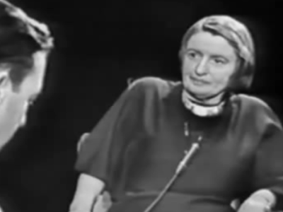
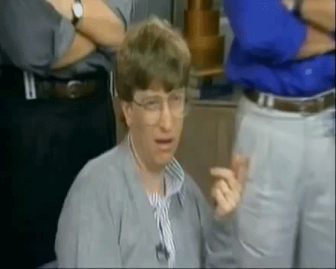
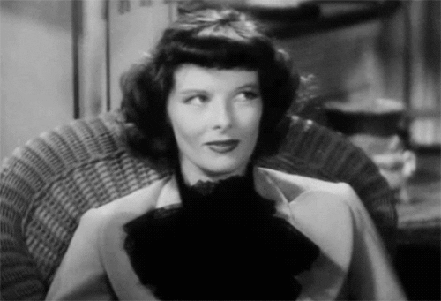
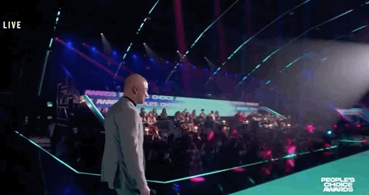
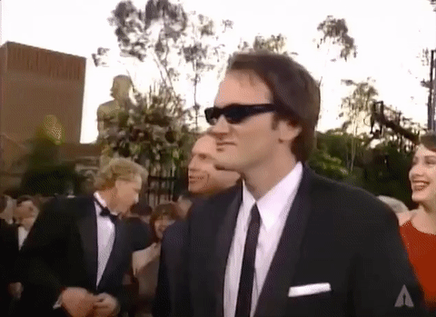
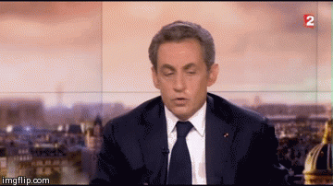
LOGICAL INTUITIVE ENERGISER - “THE ENTREPRENEUR”
All slides are copyrighted by Jack Oliver Aaron of the World Socionics Society

Slide 38
EGO BLOCK
All slides are copyrighted by Jack Oliver Aaron of the World Socionics Society
All about applying knowledge for success Rapidly absorb all useful information Make things work at maximum efficiency Implement solutions to big problems Strategic in focus, reflective on outcomes See which plans are relevant or not Can look ahead to see what won’t work Aware of risks to plan for and prevent
Notes:
Jordan Peterson P1+T2: https://www.youtube.com/watch?v=QUAZDfND_dE&t=72s
Thomas Sowell P1+T2: https://www.youtube.com/watch?v=e1aBOXlswX4

Slide 39
SUPER-EGO BLOCK
All slides are copyrighted by Jack Oliver Aaron of the World Socionics Society
Want to speak the full, factual truth Finds it wrong to distort information Aware of need to be liked to be successful Make themselves outwardly acceptable Always ‘on’ mentally, can’t switch off Unaware of natural flow and balance Can get too intense around others Work too hard, burn themselves out
Notes:
Jordan Peterson E3: https://www.youtube.com/shorts/4vku_78W5zQ
Bill Gates S4: https://www.youtube.com/watch?v=1Xhas1dXoNw

Slide 40
SUPER-ID BLOCK
All slides are copyrighted by Jack Oliver Aaron of the World Socionics Society
Relationships often too transactional Desire intimacy, unsure who to trust Collects data to test intentions of people Receptive to help in whom to trust Need to feel autonomous in action Can be intense and short-tempered Seek concrete, real achievements Fluctuate from impatience to self-doubt
Notes:
Jordan Peterson R5: https://www.youtube.com/watch?v=ZkDEq4LN-uI
Quentin Tarantino F6: https://www.youtube.com/watch?v=DTE8FPgHeE4

Slide 41
ID BLOCK
All slides are copyrighted by Jack Oliver Aaron of the World Socionics Society
Pragmatic rather than theoretical Take from theories what they can use May provide rules if useful to do so Want to break structures to improve Cast a wide net when collecting data Can entertain a broad range of interests Initially open to changing their mind Focus interests towards relevant goals
Notes:
Camille Paglia L7+I8: https://www.youtube.com/watch?v=kyPUH825Bjk

Slide 42
DOMINATION
All slides are copyrighted by Jack Oliver Aaron of the World Socionics Society
Focused on what works pragmatically Insist on not being tied down to an ideology Will refuse to simplify data to a structure Cut red tape to make improvements Provide all the facts when explaining
Notes:
Jordan Peterson P1>L7: https://www.youtube.com/watch?v=Xg2psply4no
Jordan Peterson P1>L7: https://www.youtube.com/watch?v=HCAYYPvSR0g
Thomas Sowell P1>L7: https://www.youtube.com/watch?v=tk8vUP1yewg

Slide 43
MASKING
All slides are copyrighted by Jack Oliver Aaron of the World Socionics Society
Communicate to inform, not entertain Realise that they need to engage people See risks in upsetting the wrong people Will put on a friendly, public mask if needed
Notes:
Jeff Bezos P1 -> E3: https://www.youtube.com/watch?v=AOSG5R17mo0
Yulia Tymoshenko P1 -> E3: https://www.youtube.com/watch?v=d9AxcTIspuk
Nicolas Sarkozy P1 -> E3: https://www.youtube.com/watch?v=R9Pg1ZAnFgg

Slide 44
STRUGGLE
All slides are copyrighted by Jack Oliver Aaron of the World Socionics Society
Think they need to be palatable to others Find this inaccurate and disingenuous Want to be sincere and accurate Appreciate being understood for who they are Freed from the act by intimate relationships
Notes:
Jordan Peterson E3>R5: https://www.youtube.com/watch?v=AF0FMNs5Qqg
Jordan Peterson E3>R5: https://www.youtube.com/shorts/lRGnhBbcWhg

Slide 45
DISTRACTION
All slides are copyrighted by Jack Oliver Aaron of the World Socionics Society
Want to form a close pairing with individuals Have to draw from axioms when without facts May become closed off to individual character Need to feel that they can trust individuals
Notes:
Ben Shapiro R5 -> L7: https://www.youtube.com/watch?v=PRF3r3zUGqk

Slide 46
MASTERY
All slides are copyrighted by Jack Oliver Aaron of the World Socionics Society
Balance breadth and depth of insight Look across many different ideas/influences Synthesise insights into long-term vision Weigh up both opportunities and risks Think ‘out the box’ in reaching their purpose
Notes:
Quentin Tarantino T2<I8: https://www.youtube.com/watch?v=8MGGMmXeS6I

Slide 47
GROWTH
All slides are copyrighted by Jack Oliver Aaron of the World Socionics Society
Open to ideas and perspectives But want to be strong and taken seriously Become more assertive and impatient to act Fall back on doubt and questioning if unsure
Notes:
Jordan Peterson I8 -> F6: https://www.youtube.com/watch?v=qwaLhSgi7q8
Walter White I8 -> F6: https://www.youtube.com/watch?v=I3ecbEAtgVQ

Slide 48
SUBSTITUTION
All slides are copyrighted by Jack Oliver Aaron of the World Socionics Society
Value what is profound over what is pleasant Mentally very engaged but struggle to relax Sacrifice daily maintenance for big picture Ignore details, unless relevant, then stresses
Notes:
Jordan Peterson S4 -> T2: https://www.youtube.com/shorts/tA7DAMomA2s

Slide 49
HUBRIS
All slides are copyrighted by Jack Oliver Aaron of the World Socionics Society
Blind to the peaceful, natural flow of things Yet want to be strong and impactful Try to be decisive, proactive and in charge Come off as too intense, disrupting the peace May be too hard on themselves, burning out
Notes:
Gordon Ramsay S4<F6: https://www.youtube.com/watch?v=Mz_01tjBwAE
Gordon Ramsay S4<F6: https://www.youtube.com/watch?v=PUP7U5vTMM0

Slide 50
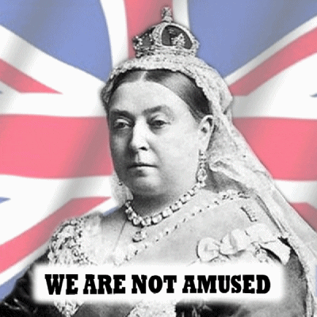
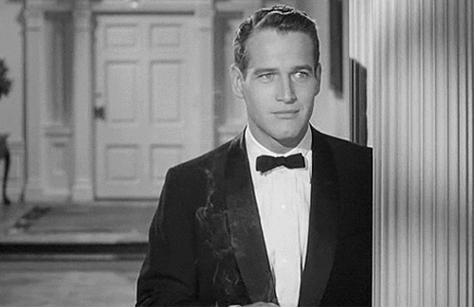
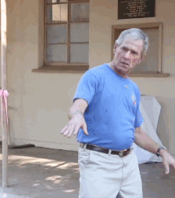

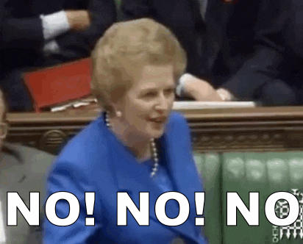

ETHICAL SENSORY INTEGRATOR - “THE GUARDIAN”
All slides are copyrighted by Jack Oliver Aaron of the World Socionics Society

Slide 51
EGO BLOCK
All slides are copyrighted by Jack Oliver Aaron of the World Socionics Society
All about evaluating personal intentions Know who they can and cannot trust Build intimacy with those they like Judge the character of those they dislike Looks at people’s actions to assess them Acts to enforce appropriate boundaries Keeps bad people at a distance Protects themselves and friends from evil
Notes:
Margaret Thatcher R1+F2: https://www.youtube.com/watch?v=68SrSkHVFwA
John McCain R1+F2: https://www.youtube.com/watch?v=AQmFMu_Sz4c

Slide 52
SUPER-EGO BLOCK
All slides are copyrighted by Jack Oliver Aaron of the World Socionics Society
Can enforce rules and structures if needed Dislike impartial, unwieldy principles Feel need to be able to justify decisions Operate in a consistent, orderly fashion Struggle thinking beyond own experience Uninterested in new theories and ideas Keep a narrow range of interests Once mind mind up, does not change it
Notes:
Margaret Thatcher L3+I4: https://www.youtube.com/watch?v=3JZlP5qQVtE

Slide 53
SUPER-ID BLOCK
All slides are copyrighted by Jack Oliver Aaron of the World Socionics Society
Can doubt which facts are relevant Unsure how to use information efficiently Doubtful of own competence Accepts expertise to make things work Become more future-oriented over time Search for a greater, spiritual purpose Start to act in service of bigger picture Can be determined to achieve goal
Notes:
George W. Bush P5+T6: https://www.youtube.com/watch?v=sX03guZU91s

Slide 54
ID BLOCK
All slides are copyrighted by Jack Oliver Aaron of the World Socionics Society
Understand mood and occasion Able to make new friends effectively Prioritise plain-speaking sincerity Can be aloof or frosty towards some Grounded in daily details Thorough in not making mistakes Can create stable environments Will disrupt harmony over personal issue
Notes:
George W. Bush E7+S8: https://www.youtube.com/watch?v=KlTFsICmDBY

Slide 55
DOMINATION
All slides are copyrighted by Jack Oliver Aaron of the World Socionics Society
Wants to be sincere to personal attitudes Insistent on being true to themselves Will not sacrifice their soul to be popular Do what they feel is right, even if unpopular Cuts through deception to see intentions
Notes:
Christopher Hitchens R1>E7: https://www.youtube.com/watch?v=bG61DKfKlGY
Christopher Hitchens R1>E7: https://www.youtube.com/watch?v=NJG-lgmPvYA
Richard Nixon R1>E7: https://www.youtube.com/watch?v=XfNjpHAMy2E

Slide 56
MASKING
All slides are copyrighted by Jack Oliver Aaron of the World Socionics Society
Focused on their personal attitudes Find structures too impersonal and rigid Want to treat different people differently Feel they must justify decisions with rules
Notes:
Margaret Thatcher R1 -> L3: https://www.youtube.com/watch?v=dhl680YRT6g
Margaret Thatcher R1 -> L3: https://www.youtube.com/watch?v=okHGCz6xxiw

Slide 57
STRUGGLE
All slides are copyrighted by Jack Oliver Aaron of the World Socionics Society
Want to feel competent in what they do Lacks confidence in their competence Turn to enforcing clear rules and systems Not pragmatic or common-sense driven Need to meet experts who can advise them
Notes:
Margaret Thatcher L3>P5: https://www.youtube.com/watch?v=ZcmkeQ2fYr0

Slide 58
DISTRACTION
All slides are copyrighted by Jack Oliver Aaron of the World Socionics Society
Normally accepting of practical advice Occasionally affected by strong emotions Becomes uninterested in practical help Can become emotional and irrational

Slide 59
MASTERY
All slides are copyrighted by Jack Oliver Aaron of the World Socionics Society
Outwardly relaxed, but with inner steel Balance intensity with ability to sustain energy Highly disciplined in preventing mistakes Stand their ground, defend their space Establish autonomy by managing the details
Notes:
Marco Pierre White F2<S8: https://www.youtube.com/watch?v=GSOu3-cymnY

Slide 60
GROWTH
All slides are copyrighted by Jack Oliver Aaron of the World Socionics Society
Take daily comforts for granted Grows more visionary and strategic over time Chance of their personal purpose being false Regresses to focus on mundane details
Notes:
Margaret Thatcher S8 -> T6: https://www.youtube.com/watch?v=QiMs165tVdw

Slide 61
SUBSTITUTION
All slides are copyrighted by Jack Oliver Aaron of the World Socionics Society
Derives views from reality, not speculation Does not tolerate ambiguity Shuts down other perspectives Acts quickly rather than giving a chance
Notes:
Margaret Thatcher I4 -> F2: https://www.youtube.com/watch?v=MvSef2zTFds
Margaret Thatcher I4 -> F2: https://www.youtube.com/watch?v=dnwG9lTd4-M
George Bush I4 -> F2: https://www.youtube.com/watch?v=HbP8HGxrgo8

Slide 62
HUBRIS
All slides are copyrighted by Jack Oliver Aaron of the World Socionics Society
Blind to possibilities outside of experience Yet want to align to a greater purpose Commit to a far-reaching strategy Remain stubborn, not considering alternatives May advance blindly along the wrong path
Notes:
Margaret Thatcher I4<T6: https://www.youtube.com/watch?v=rQ-M0KEFm9I
George Bush I4<T5: https://www.youtube.com/watch?v=_tcUogFo9yE

Slide 63
Any Questions?
All slides are copyrighted by Jack Oliver Aaron of the World Socionics Society
Email Jack at worldsocionics@hotmail.com

